Slide 1
WIA1005 Network Technology Foundation
Chapter 8
Switching Concept

Slide 2
Contents
Introduction
Switching Domain
Switch Configuration
Switch Security Management

Slide 3
Introduction
Access Layer - represents the network edge, where the primary function of an access layer switch is to provide network access to the user.
Distribution Layer – the interfaces between the access layer and the core layer. Providing high availability through redundant distribution layer switches.
Core Layer – The network backbone. It connects several layers of the campus network. The core layer serves as the aggregator for all of the other campus blocks and ties the campus together with the rest of the network.

Slide 4
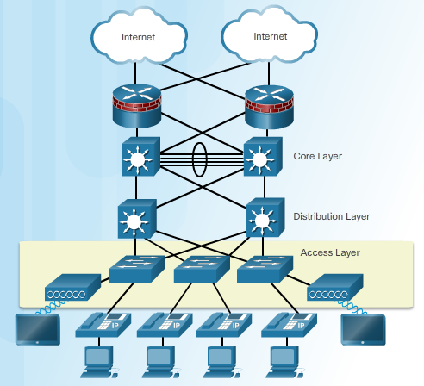
Introduction

Slide 5
Introduction
The decision on how a switch forwards traffic is made based on the flow of that traffic.
  Ingress - This is used to describe the port where a frame enters the device.
  Egress - This is used to describe the port that frames will use when leaving the device.
A LAN switch forwards traffic based on the ingress port and the destination MAC address of an Ethernet frame.
Switch has a MAC address table that stored in content addressable memory (CAM) which is a special type of memory used in high-speed searching applications.

Slide 6
Introduction
Step 1. Learn - Examining the Source MAC Address
Every frame that enters a switch is checked for new information to learn. It does this by examining the source MAC address of the frame and port number where the frame entered the switch:
  If the source MAC address does not exist in the MAC address table, the MAC address and incoming port number are added to the table.
  If the source MAC address does exist, the switch updates the refresh timer for that entry. By default, most Ethernet switches keep an entry in the table for five minutes.

Slide 7
Introduction
Step 2. Forward - Examining the Destination MAC Address
If the destination MAC address is a unicast address, the switch will look for a match between the destination MAC address of the frame and an entry in its MAC address table:
  If the destination MAC address is in the table, it will forward the frame out of the specified port.
  If the destination MAC address is not in the table, the switch will forward the frame out all ports except the incoming port. This is called an unknown unicast.
If the destination MAC address is a broadcast or a multicast, the frame is also flooded out all ports except the incoming port.

Slide 8
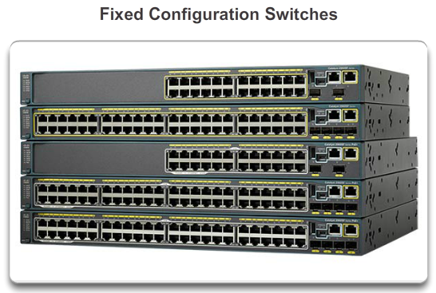
Introduction
Fixed Configuration Switches
  Fixed configuration switches do not support features or options beyond those that originally came with the switch.

Slide 9
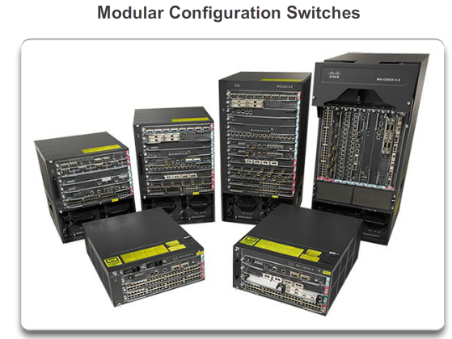
Introduction
Modular Configuration Switches
  Modular configuration switches typically come with different sized chassis that allow for the installation of different numbers of modular line cards .

Slide 10
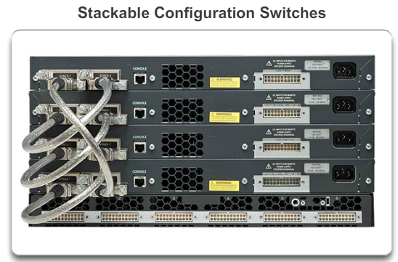
Introduction
Stackable Configuration Switches
  Stackable configuration switches can be interconnected using a special cable that provides high-bandwidth throughput between the switches.
  The stacked switches effectively operate as a single larger switch. Stackable switches are desirable where fault tolerance and bandwidth availability are critical.

Slide 11
Introduction
  A switch stack can consist of up to nine switches connected through their StackWise ports.
  One switch called the stack master controls the operation of the stack. Switch stacks are managed using a single IP address. The master contains the saved and running configuration files for the stack and each member has a current copy of these files for backup purposes.
  If the master becomes unavailable, there is an automatic process to elect a new master from the remaining stack members. The highest stack-member priority value will become the master.

Slide 12
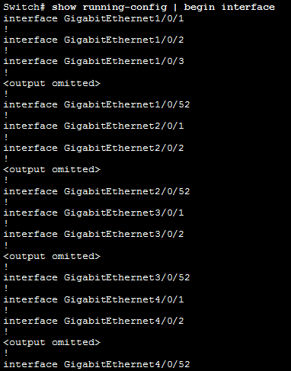
Introduction
  Every switch is uniquely identified by its own stack member number. The first number after the interface-type is the stack-member number.

Slide 13
Switching Domain
Ethernet switch ports will auto-negotiate full-duplex when the adjacent device can also operate in full-duplex.
If the switch port is connected to a device operating in half-duplex, such as a legacy hub, then the switch port will operate in half-duplex.
If an Ethernet switch port is operating in half-duplex, each segment is in its own collision domain. There are no collision domains when switch ports are operating in full-duplex.

Slide 14
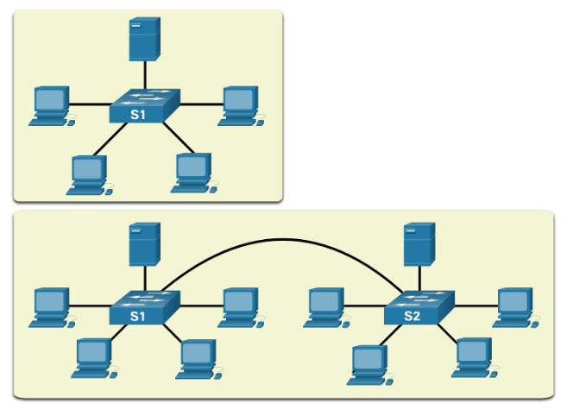
Switching Domain
A collection of interconnected switches forms a single broadcast domain. This broadcast domain is referred to as the MAC broadcast domain. The MAC broadcast domain consists of all devices on the LAN that receive broadcast frames from a host.

Slide 15
Switching Domain
Characteristics of switches :
  Fast port speeds
    Most access layer switches support 100 Mbps and 1 Gbps port speeds.
    Distribution layer switches support 100 Mbps, 1 Gbps, and 10 Gbps port speeds
    Core layer and data center switches may support 100 Gbps, 40 Gbps, and 10 Gbps port speeds.
  Fast internal switching
    Switches use a fast internal bus or shared memory to provide high performance.

Slide 16
Switching Domain
  Large frame buffers
    Switches use large memory buffers to temporarily store more received frames before having to start dropping them. This enables ingress traffic from a faster port (e.g., 1 Gbps) to be forwarded to a slower (e.g., 100 Mbps) egress port without losing frames.
  High port density
    A high port density switch lowers overall costs because it reduces the number of switches required. For instance, if 96 access ports were required, it would be less expensive to buy two 48-port switches instead of four 24-port switches.

Slide 17
Switch Configuration
First, the switch loads a power-on self-test (POST) program stored in ROM. POST checks the CPU subsystem. It tests the CPU, DRAM, and the portion of the flash device that makes up the flash file system.
Next, the switch loads the boot loader software. The boot loader is a small program stored in ROM that is run immediately after POST successfully completes. The boot loader performs low-level CPU initialization. It initializes the CPU registers, which control where physical memory is mapped, the quantity of memory, and its speed.

Slide 18

Switch Configuration
The boot loader initializes the flash file system on the system board.
Finally, the boot loader locates and loads a default IOS operating system software image into memory and gives control of the switch over to the IOS. The IOS operating system then initializes the interfaces using the commands found in the configuration file, startup configuration, which is stored in NVRAM.

Slide 19
Switch Configuration
The switch have several status LED indicator lights.
System LED
  LED off - System is OFF.
  LED is green - System is operating normally.
  LED is amber - System is not functioning properly.
Redundant Power System (RPS) LED
Port Status LED
Port Duplex LED
Port Speed LED
Power over Ethernet (PoE) Mode LED

Slide 20
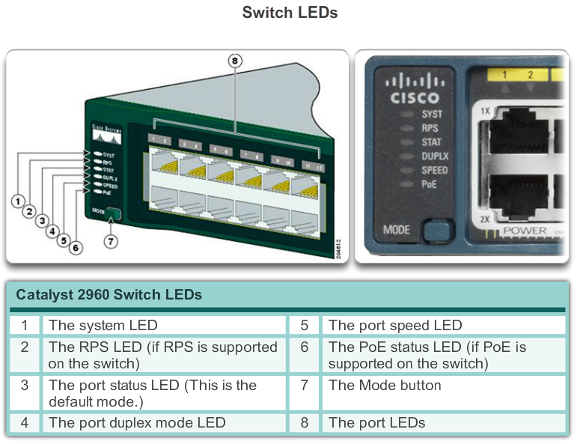
Switch Configuration

Slide 21
Switch Configuration
How to access boot loader?
  Step 1. Connect a PC by console cable to the switch console port. Configure terminal emulation software to connect to the switch.
  Step 2. Unplug the switch power cord.
  Step 3. Reconnect the power cord to the switch and, within 15 seconds, press and hold down the Mode button while the System LED is still flashing green.
  Step 4. Continue pressing the Mode button until the System LED turns briefly amber and then solid green; then release the Mode button.
  Step 5. The boot loader switch: prompt appears in the terminal emulation software on the PC.

Slide 22
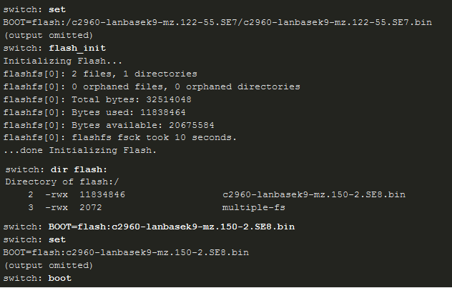
Switch Configuration

Slide 23
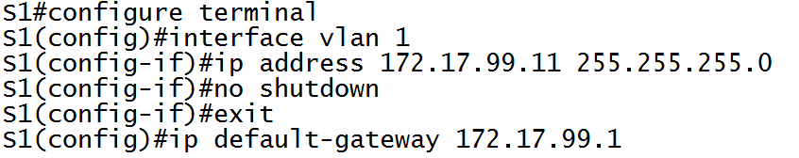
Switch Configuration
To prepare a switch for remote management access, the switch must be configured with an IP address, subnet mask and the default gateway.
The switch virtual interface (SVI) should be assigned an IP address.
By default, the switch is configured to have the management of the switch controlled through VLAN 1.

Slide 24
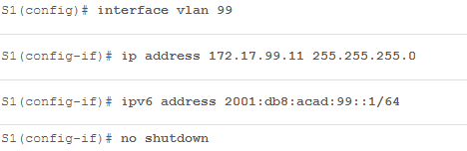
Switch Configuration
For security purposes, it is considered a best practice to use a VLAN other than VLAN 1 for the management VLAN.
In order to configure IPv6 on the Switch (2960), you will need to enter sdm prefer dual-ipv4-and-ipv6 default and then reload the switch.

Slide 25
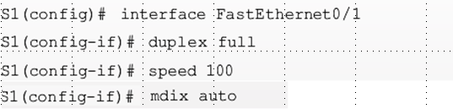
Switch Configuration
Switch ports can be manually configured with specific duplex and speed settings.
The duplex command accepts auto, full and half.
The speed command accepts the speed in Mbps.
We can enable auto-MDIX on the switch ports. When auto-MDIX is enabled, the interface automatically detects the required cable connection.

Slide 26
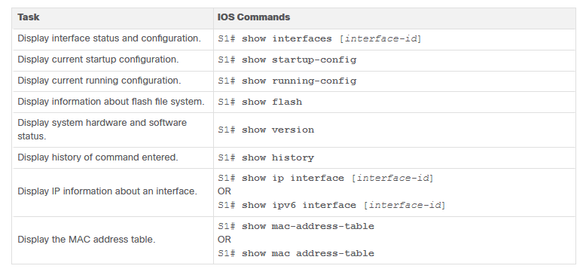
Switch Configuration

Slide 27
Switch Security Management
Secure Shell (SSH) is a protocol that provides a secure management connection to a remote device.
Telnet is an older protocol that uses insecure plaintext transmission of both the login authentication (username and password) and the data transmitted between the communicating devices.
SSH provides security for remote connections by providing strong encryption when a device is authenticated (username and password) and also for the transmitted data between the communicating devices.
SSH is assigned to TCP port 22. Telnet is assigned to TCP port 23.

Slide 28
Switch Security Management
Configuring SSH
  Configure the hostname.
  Configure the IP domain name.
  Generate RSA key pairs - A minimum modulus size of 1,024 bits is required.
  Configure user authentication.
  Configure the vty lines.
Enabling SSH version 2
  ip ssh version 2
  show ip ssh

Slide 29
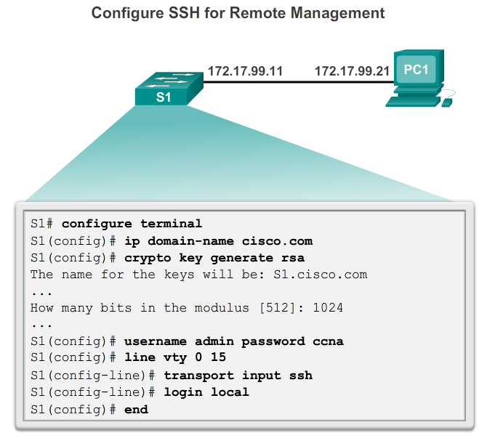
Switch Security Management

Slide 30
Switch Security Management
MAC Address Flooding
  The MAC address table in a switch contains the MAC addresses associated with each physical port and the associated VLAN for each port.
  When a Layer 2 switch receives a frame, the switch looks in the MAC address table for the destination MAC address.
  If the MAC address does not exist in the MAC address table, the switch floods the frame out of every port on the switch, except the port where the frame was received.

Slide 31
Switch Security Management
  MAC address tables are limited in size. MAC flooding attacks make use of this limitation to overwhelm the switch with fake source MAC addresses until the switch MAC address table is full. (the macof attacking tool)
  When this occurs, the switch treats the frame as an unknown unicast and begins to flood all incoming traffic out all ports on the same VLAN without referencing the MAC table.
  This condition allows a threat actor to capture all of the frames sent from one host to another on the local LAN or local VLAN.

Slide 32
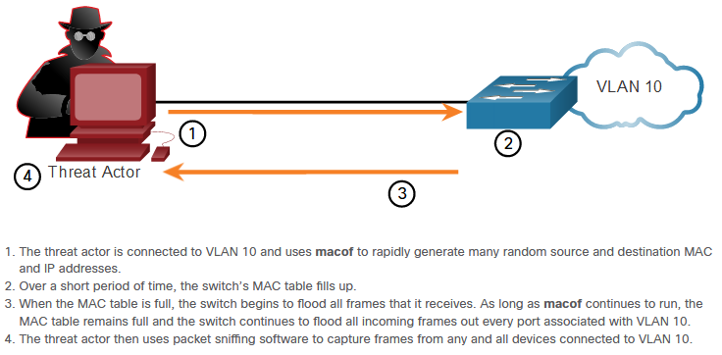
Switch Security Management

Slide 33
Switch Security Management
All switch ports should be secured using port security. Port security limits the number of valid MAC addresses allowed on a port.
By limiting the number of permitted MAC addresses on a port to one, port security can be used to control unauthorized access to the network
If a port is configured as a secure port and the maximum number of MAC addresses is reached, any additional attempts to connect by unknown MAC addresses will generate a security violation.
A security violation also occurs when an address learned or configured on one secure interface is seen on another secure interface in the same VLAN.

Slide 34
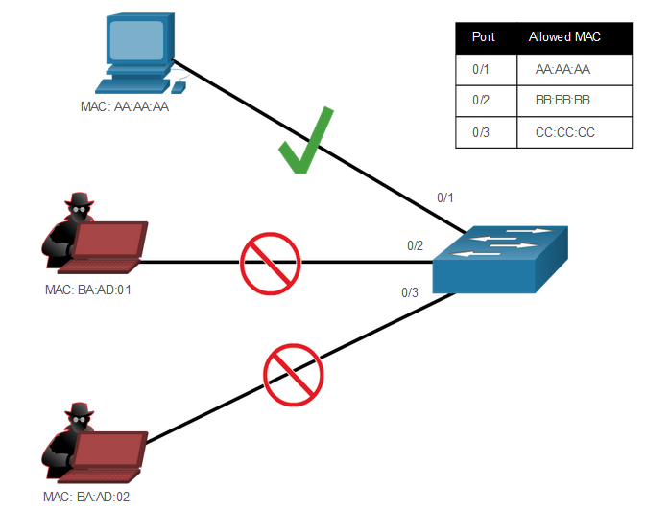
Switch Security Management

Slide 35
Switch Security Management
There are a number of ways to configure port security.
Static secure MAC addresses - MAC addresses that are manually configured on a port.
Dynamic secure MAC addresses - MAC addresses that are dynamically learned and stored only in the address table. MAC addresses configured in this way are removed when the switch restarts.
Sticky secure MAC addresses - MAC addresses that can be dynamically learned or manually configured and then stored in the address table and added to the running configuration.

Slide 36
Switch Security Management
An interface can be configured for one of three violation modes.
Protect - When violation occurs, packets with unknown source addresses are dropped until a sufficient number of secure MAC addresses are removed, or the number of maximum allowable addresses is increased. There is no notification that a security violation has occurred.
Restrict - When violation occurs, packets with unknown source addresses are dropped until a sufficient number of secure MAC addresses are removed, or the number of maximum allowable addresses is increased. In this mode, there is a notification that a security violation has occurred.

Slide 37
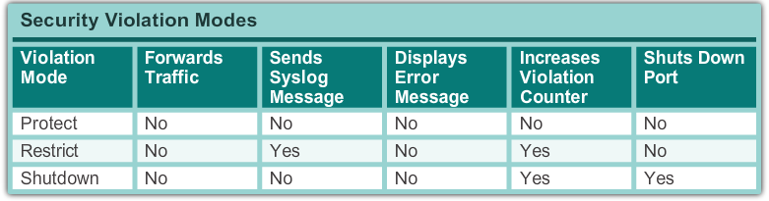
Switch Security Management
Shutdown - In this (default) violation mode, a port security violation causes the interface to immediately become error-disabled and turns off the port LED. It increments the violation counter.

Slide 38
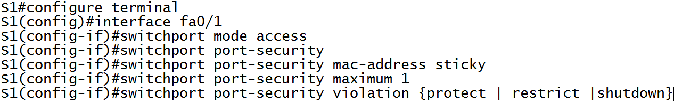
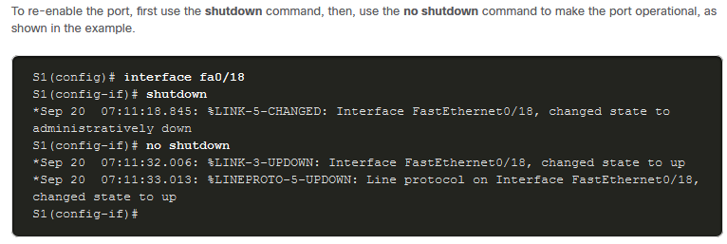
Switch Security Management

Slide 39
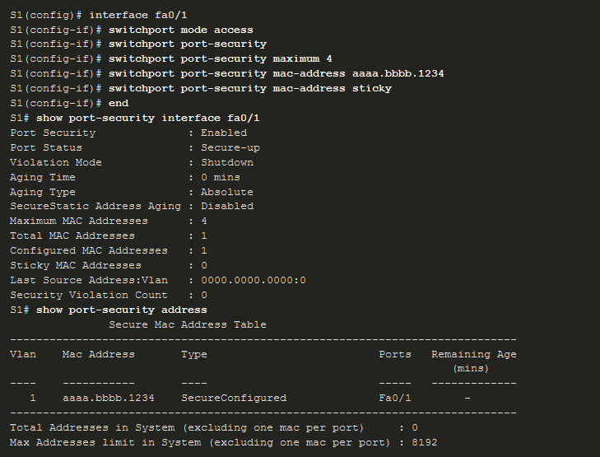
Switch Security Management

Slide 40
Switch Security Management
Port security aging can be used to set the aging time for static and dynamic secure addresses on a port. It is used to remove secure MAC addresses on a secure port without manually deleting the existing secure MAC addresses.
Two types of aging:
  Absolute - The secure addresses on the port are deleted after the specified aging time.
  Inactivity - The secure addresses on the port are deleted only if they are inactive for the specified aging time.
Aging time limits can also be increased to ensure past secure MAC addresses remain, even while new MAC addresses are added.

Slide 41
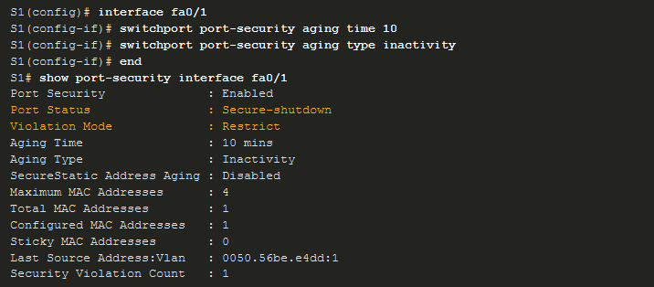
Switch Security Management

